Slide 1

Lea ning
Week 2:
Introduction to packages and data frame

Slide 2
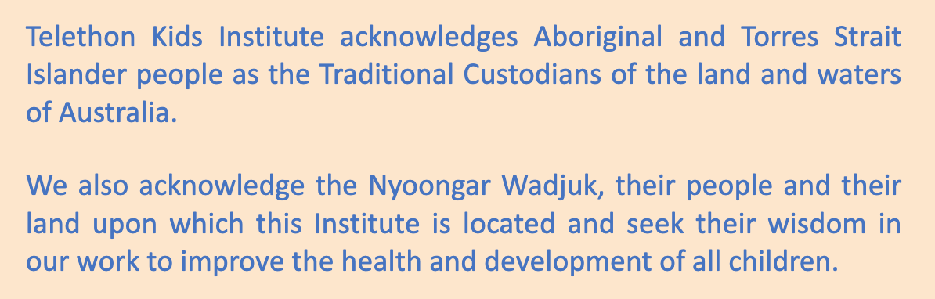

Slide 3
What’s on for today
Recap from last class:
R studio setup
Vectors and data frames: basic navigation
An introduction to the concept of “tidy data” for the excel user
An introduction to R packages
Reading a data set into R (hands-on R lesson)
Getting to know your data set using R commands (hands-on R lesson)

Slide 4
Recap from last class

Slide 5
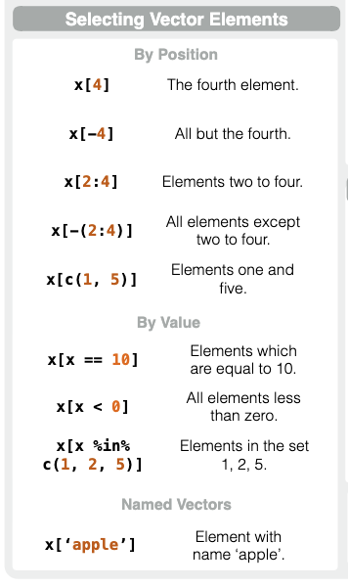
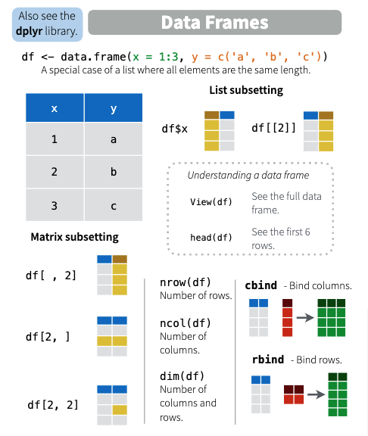

Slide 6
An introduction to tidy data

Slide 8
What is tidy data?
Tidy data is a standard way of mapping the meaning of a dataset to its structure. A dataset is messy or tidy depending on how rows, columns and tables are matched up with observations, variables and types. In tidy data: Each variable forms a column. Each observation forms a row.
-CRAN

Slide 9
What does this mean to you
Many of us that collect and use data in the lab do not use it with programs like R. What we do may make perfect sense to us, and make things easier at the bench
However, there are clever ways to form good habits, that DON’T make your life (much) harder, but will also make it easier for you to:
Analyze your data in R or Python one day
Share your data with others that may help you analyze your data using computer languages

Slide 10
Collecting and saving your data
Most of us use excel to collect our data. What might this look like?

Slide 11
An example: spot the issues

Slide 12
Sample boxmaps: spot the issues

Slide 13
Collecting your data
In drawing on our knowledge of data sets that we typically load into R, each data file contains a discrete data frame of observations and values. Free text, gaps, colour codes, or formulas all create problems.

Slide 14
Is excel always forbidden?
No. It is a handy tool, and if used properly, can still be used easily with R.
More later with Emma

Slide 15
Part 1: In summary
The CSV of TXT file format is likely the best choice to use with our types of data. However, you can use excel. When you do, follow these tips:
DO: format your data in uniform ways
DO: use colours and lines to help you visualize your data without storing crucial information
DON’T: break up your data using gaps
DON’T: take notes on the side in random places
DON’T: store information as colour codes

Slide 16
Tidy data: principles
Each variable forms a column
Each variable should store one type of information
Each observation forms a row
The content of each cell is called a value

Slide 17
Part 2: breaking down “tidy data”
LeaRning_week2_cfu_data.csv
A variable
An observation
A value (60)

Slide 18
Untidy data: some examples
What rules are being violated here?

Slide 19
Today we will load some data into R. But first, we need a brief introduction to packages

Slide 20
Package Primer

Slide 21
What is a “package”?
An R package is a unit of shareable code. Think of it like a suite of tools, documentation, and packages, custom-tailored to a specific task
They are written in standardized ways so that anyone can install them and use them with your R program
Think of it like some software you are likely used to
Base R: statistical tests
ggplot2: nice graphics
The tidyverse
dplyr (filtering, pivot tables)
reshape2 (re-arranging data)
tidyr (text to columns)

Slide 22
What is a package?
Unlike software, R packages are free to you
They are downloaded using the install.packages() function
They are “opened” using the library() function

Slide 23
Let’s get ready to “read in” our data. First, a brief overview of what reading data looks like.

Slide 24
An introduction to reading data

Slide 25
How is data “read” into R?
Unlike last class, we won’t go on forever typing our data into R
Different types of data are read into R using the read() family of functions
Here, note that the file path to your data is very important
Project folder
Rdata

Slide 26
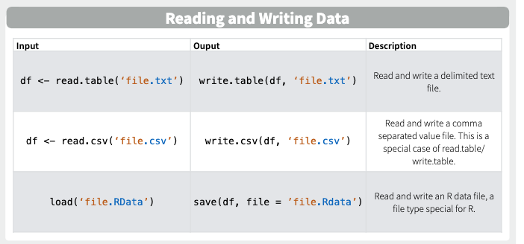

Slide 27
YOUR TURN: let’s install some packages, read in a data set, and explore it in R

